Slide 1
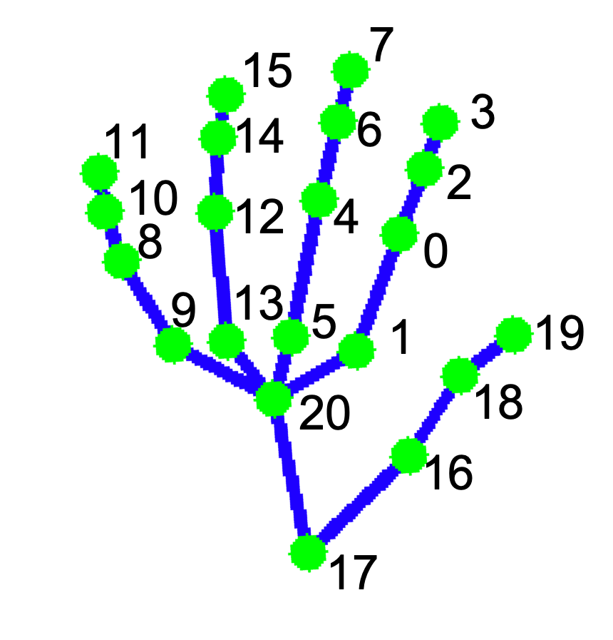
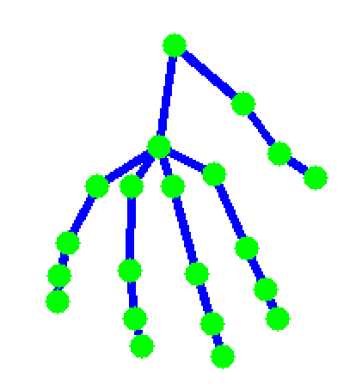
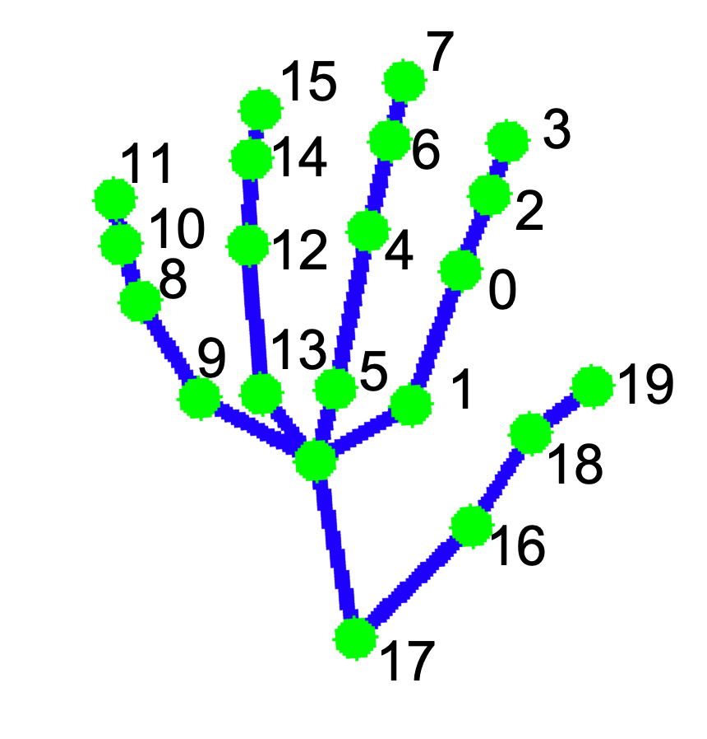
7
15
3
11
14
6
10
2
12
4
8
0
9
13
5
1
19
20
18
16
17

Slide 2
OpenPose

Slide 3
